Slide 1
Internship Studio Task: 1
SUBMITTED BY: SHACHI JAIN

Slide 2


Slide 3
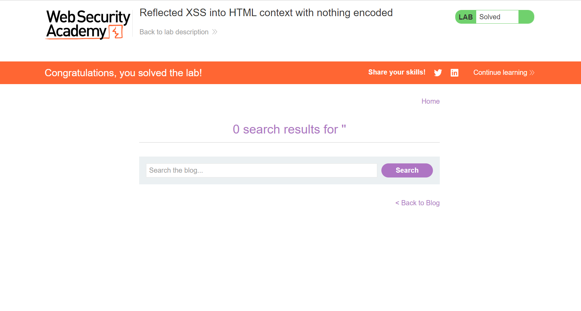

Slide 4
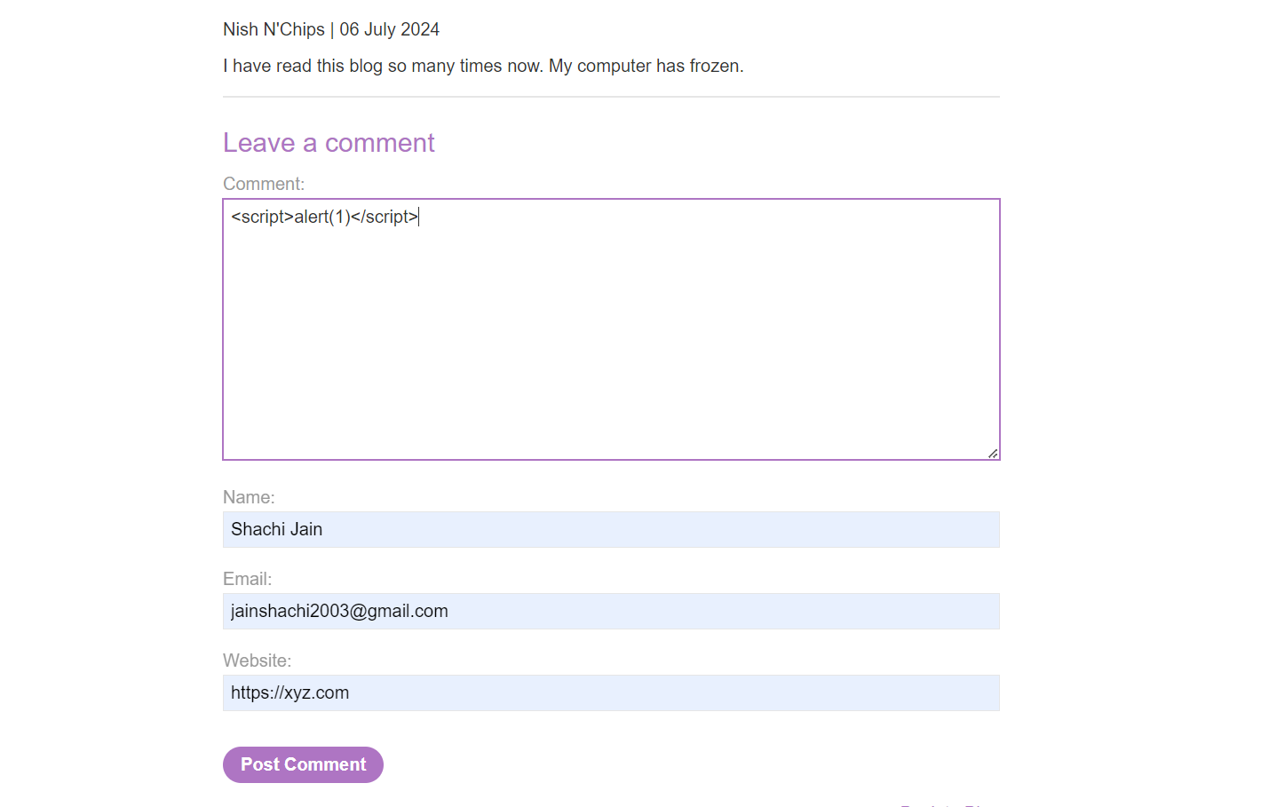

Slide 5
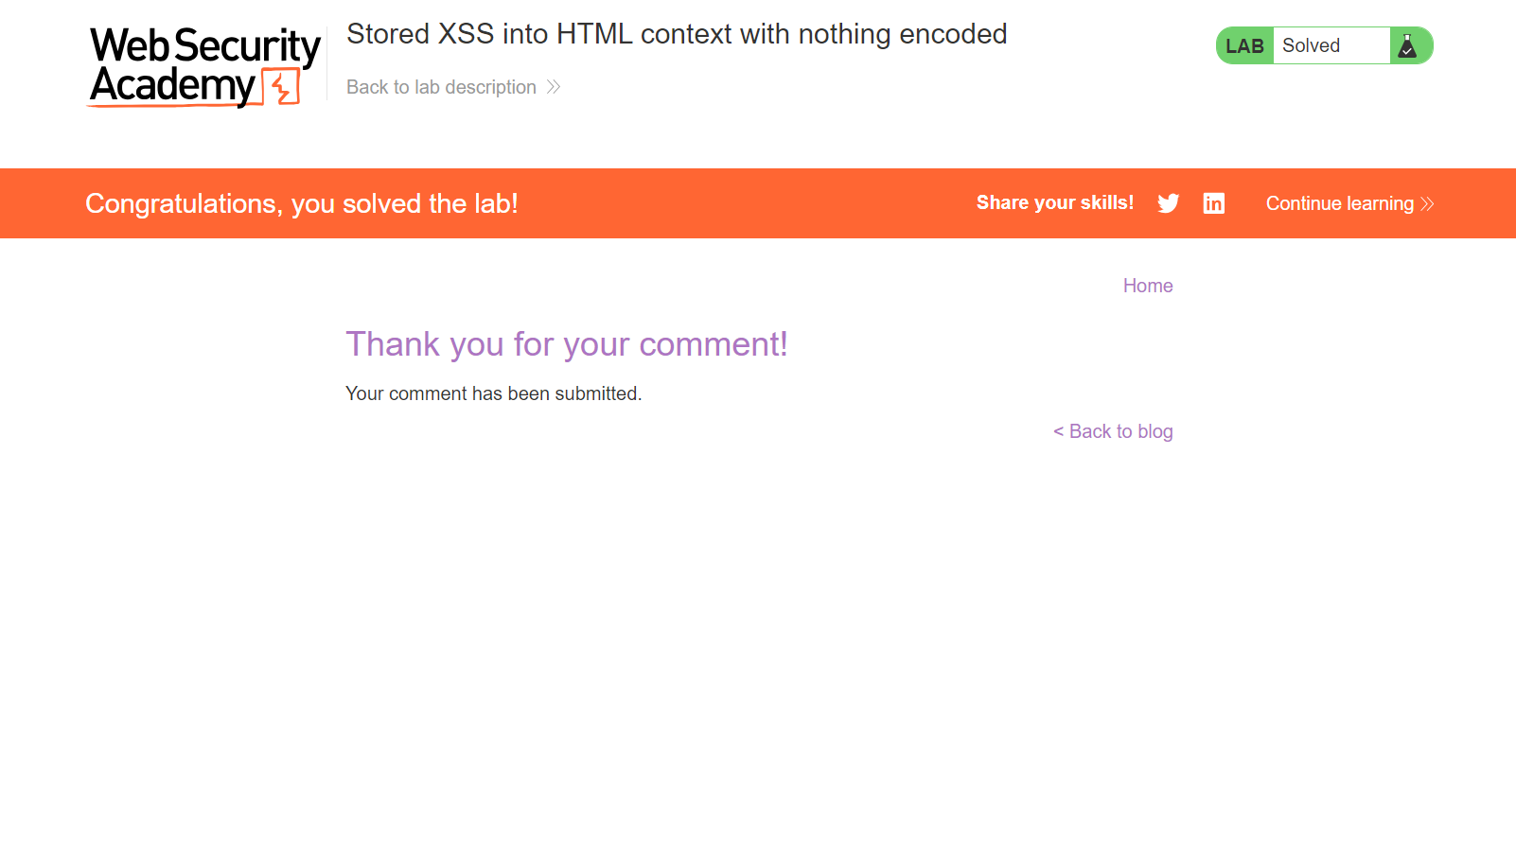

Slide 6


Slide 7
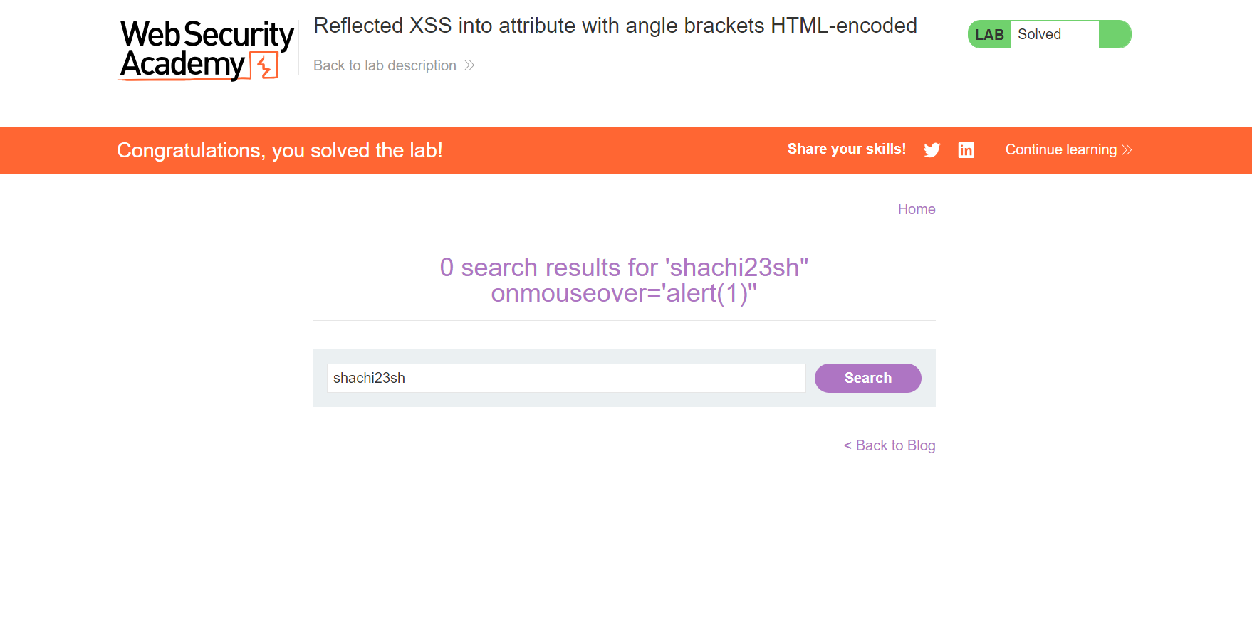

Slide 8
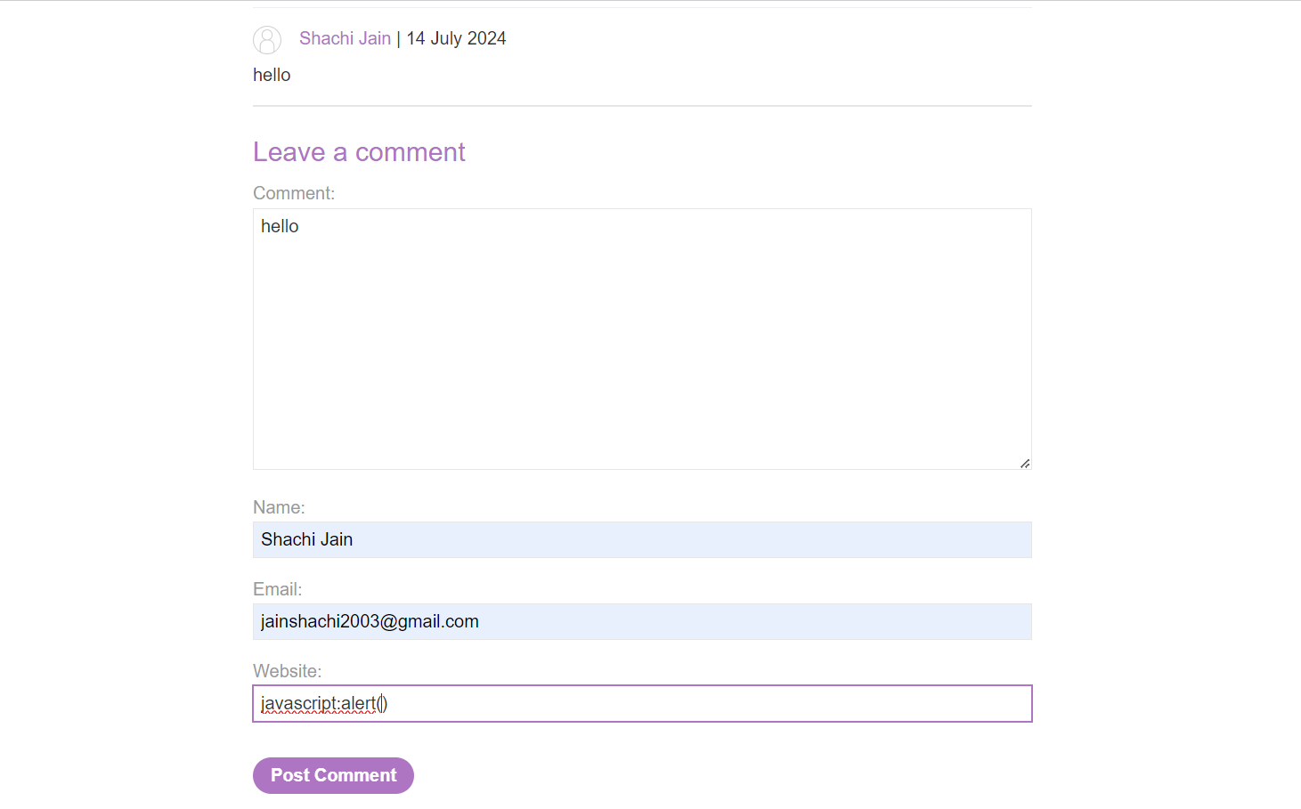

Slide 9
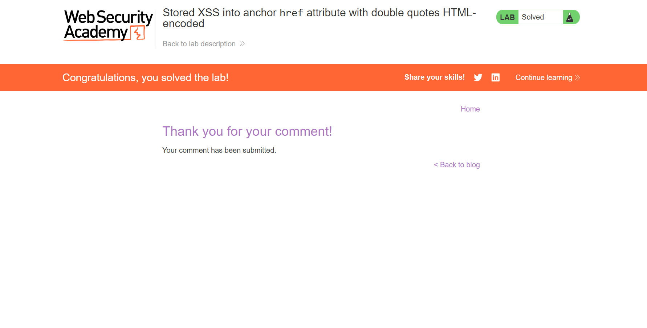

Slide 10
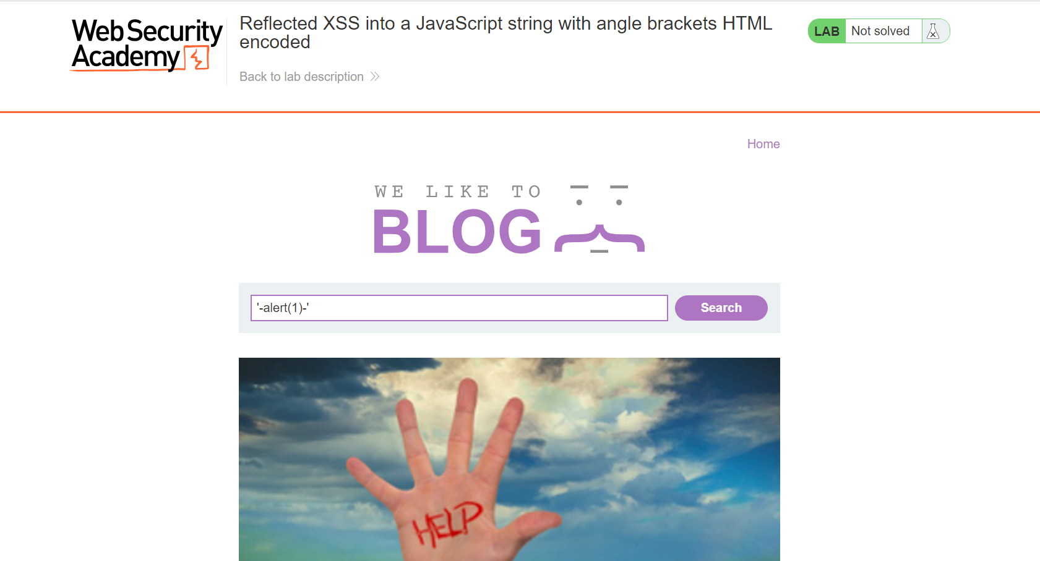

Slide 11
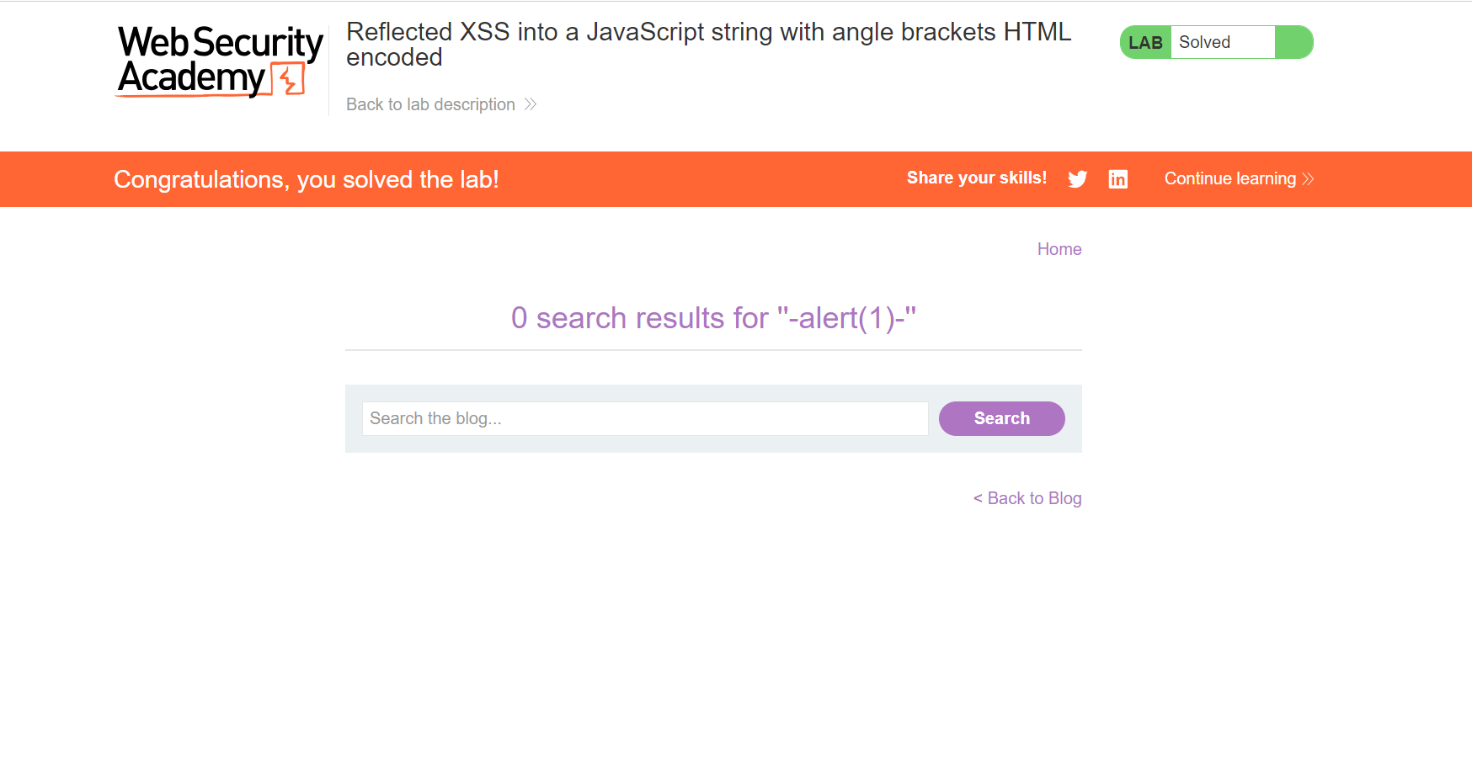

Slide 12
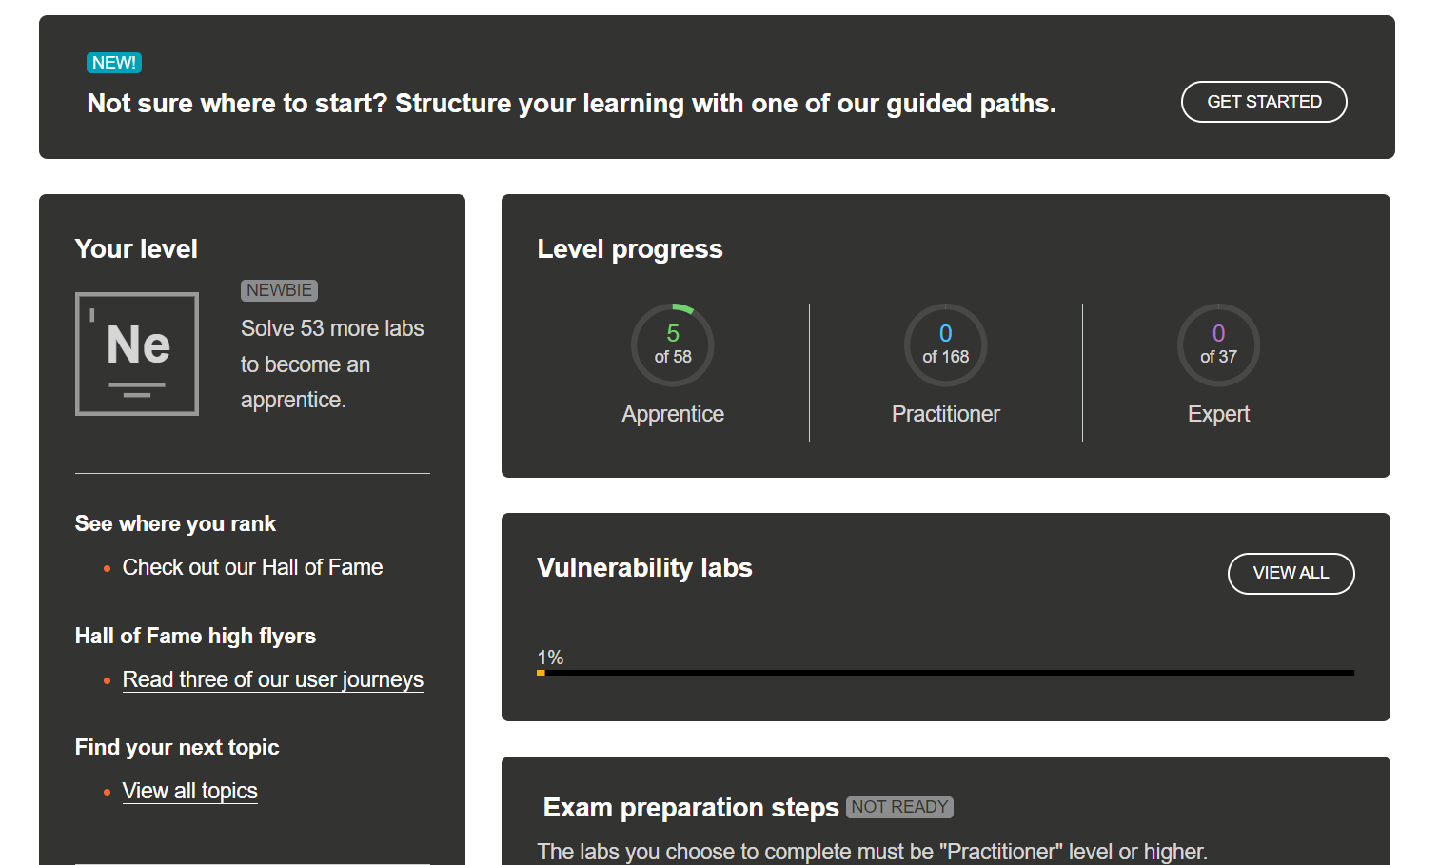

Slide 13
POC: The above are the screenshot of the portswigger lab. I solved 5 labs as per the task given. I find some Cross Site Scripting (XSS) vulnerability which are required to be fixed to protect these websites to be hacked. The hacker can steal the user data or company’s confidential information. That’s the answer of the task 1.

Slide 14
THANKYOU…

